Slide 1
Web system Architecture

Slide 2
ARCHITECTURE
The WWW today is a distributed client/server service, in which a client using a browser can access a service using a server. However, the service provided is distributed over many locations called sites.

Slide 3
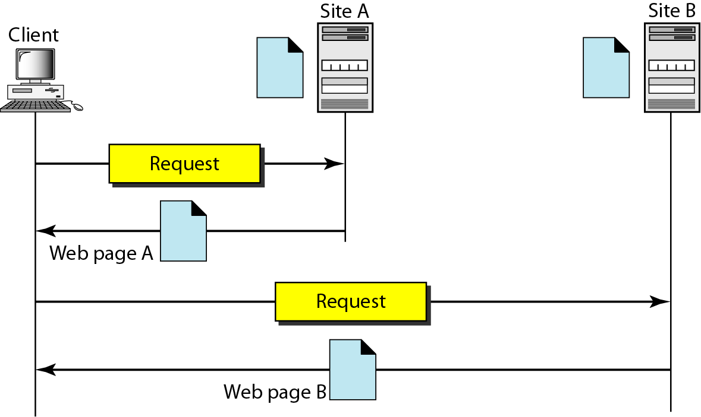
Architecture of WWW

Slide 4
Browser
Each browser usually consists of three parts: a controller, client protocol, and interpreters.
The controller receives input from the keyboard or the mouse and uses the client programs to access the document.
After the document has been accessed, the controller uses one of the interpreters to display the document on the screen.
The client protocol can be one of the protocols described previously such as FTP or HTTP
The interpreter can be HTML, Java, or JavaScript, depending on the type of document.

Slide 5
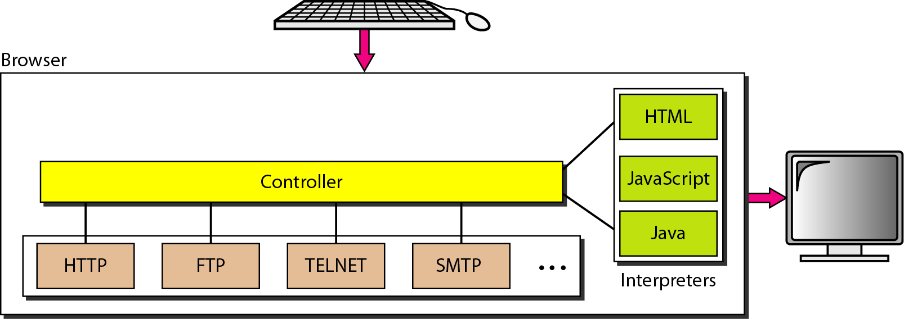
Browser

Slide 6
Server
The Web page is stored at the server.
Each time a client request arrives, the corresponding document is sent to the client.
A server can also become more efficient through multithreading or multiprocessing.
In this case, a server can answer more than one request at a time.

Slide 7
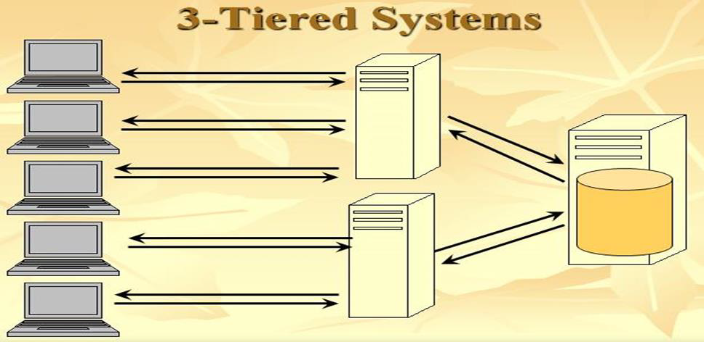
A web browser is the first tier (presentation).
An engine using some dynamic Web content technology (such as ASP, ASP.NET, CGI, ColdFusion, JSP/Java, PHP, Perl, Python, Ruby on Rails or Struts2) is the middle tier .
A database is the third tier (storage).

Slide 8
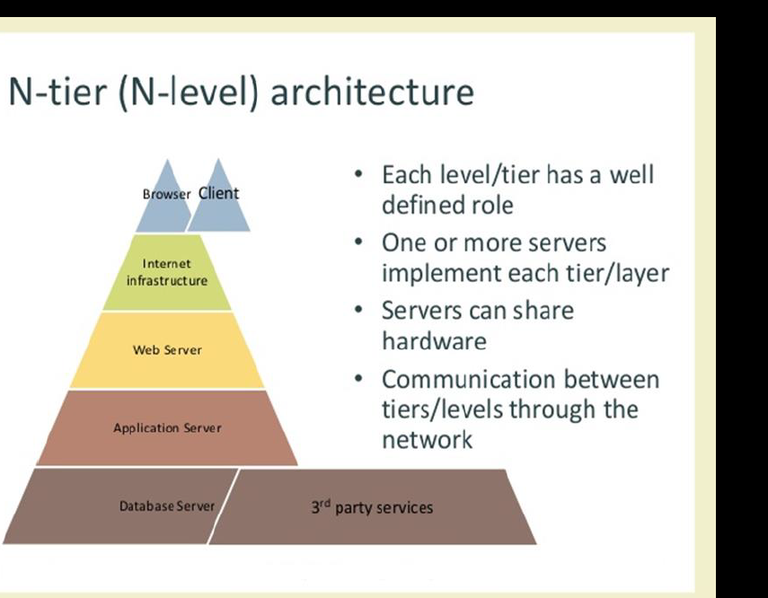

Slide 9
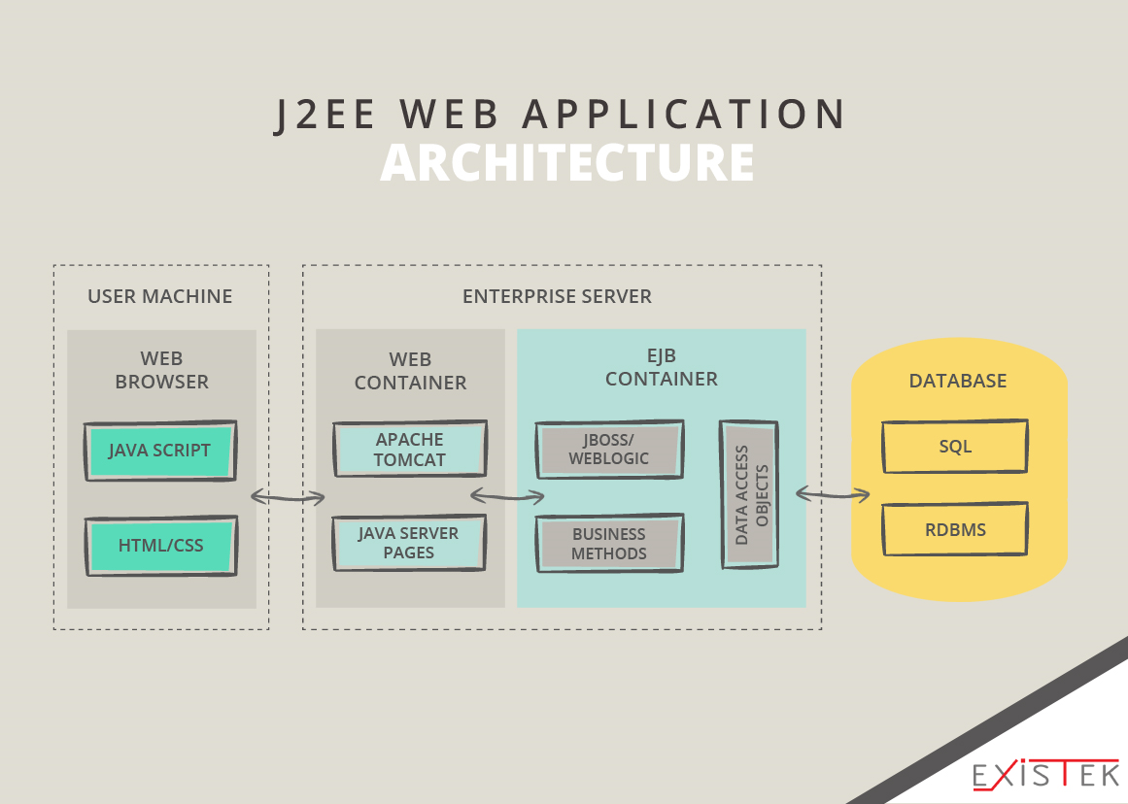

Slide 10
